Slide 1
10. Correlation and Large Deviations
ENGG 2760A / ESTR 2018: Probability for Engineers
Fall 2020

Slide 2

Measuring dependence
Cov[X, Y] = E[(X – E[X])(Y – E[Y])]
Cov[X, Y]
Corr[X, Y] =
√Var[X] Var[Y]

Slide 3
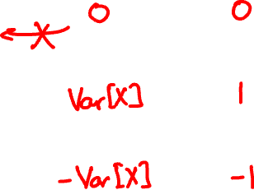
Measuring dependence
Cov
Corr
X, Y ind.
Y = X
Y = –X
Warning: Zero-covariance is not independence!

Slide 4





X = 1 or -1
Y = X + N
Cov[X, Y] =
Corr[X, Y] =

Slide 5
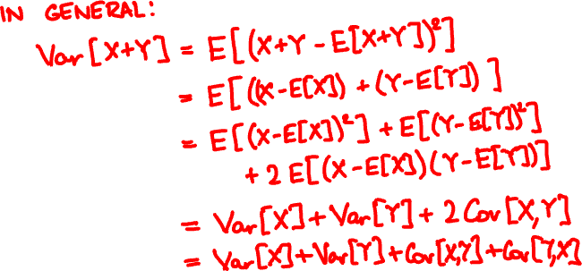
Variance of a sum
Var[X + Y] = Var[X] + Var[Y] if independent

Slide 6

Variance of a sum
Var[X₁ + … + X_{n}] = Var[X₁] + … + Var[X_{n}]
if every pair X_{i}, X_{j} is independent.

Slide 7



n people throw their hats in a box and pick one out at random. What is the variance of the number of people who get their own?

Slide 8
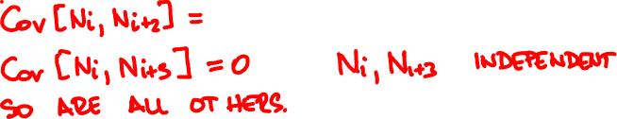
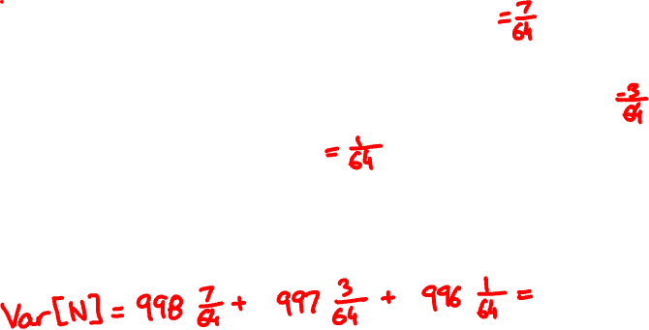
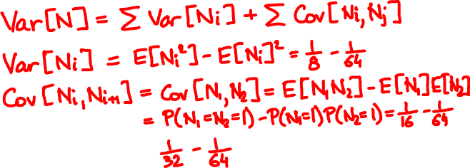
In 1000 fair coin tosses, what is the variance of the number of HHH streaks?

Slide 9
Many times we do not need to calculate probabilities exactly
An approximate or qualitative estimate often suffices
P(magnitude 7+ earthquake within 10 years) = ?

Slide 10

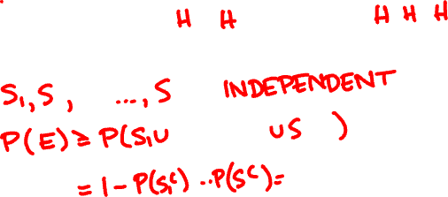

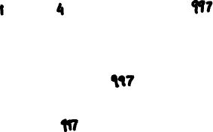
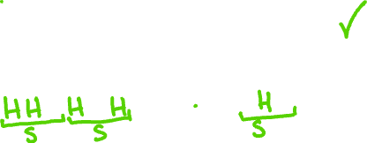
I toss a coin 1000 times. The probability that I get a streak of 3 consecutive heads is
A
B
C
< 10%
≈ 50%
> 90%

Slide 11
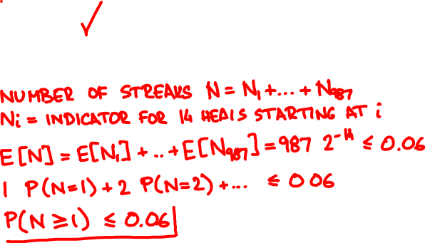
I toss a coin 1000 times. The probability that I get a streak of 14 consecutive heads is
A
B
C
< 10%
≈ 50%
> 90%

Slide 12
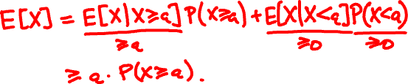
Markov’s inequality
For every non-negative random variable X and every value a:
P(X ≥ a) ≤ E[X] / a.
Proof

Slide 13

100 people randomly redistribute their hats. What is the probability at least 10 people get their hat back?

Slide 14
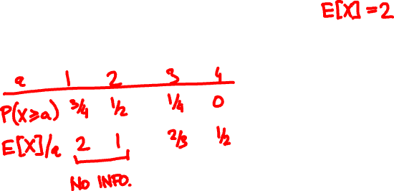
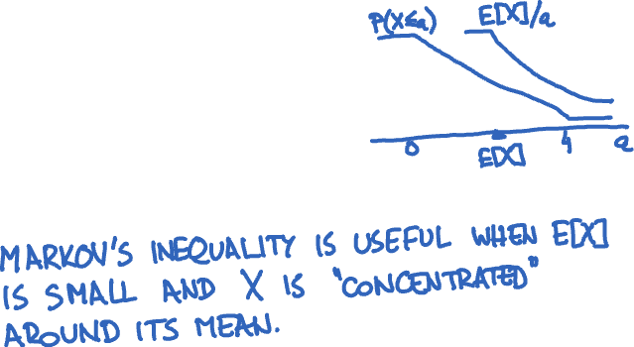
X = Uniform(0, 4). How does P(X ≥ x) compare with Markov’s inequality?

Slide 15

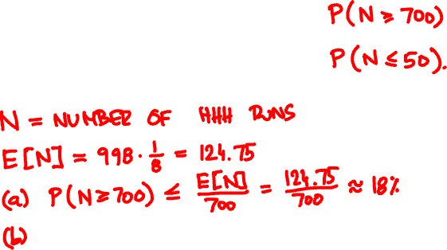


I toss a coin 1000 times. What is the probability I get 3 consecutive heads
(a) at least 700 times
(b) at most 50 times

